Slide 1
BUZZT Market Size
Ivan Ocon
Enrique Gonzalez
Rodrigo Rodriguez

Slide 2
Market size
Over 54,500 dance studio businesses in the United States
Dance studio businesses saw a 3.1% growth in total number of businesses
Dance studios have a $4 billion market size in the US
Dance studios saw a 1.8% US market size growth

Slide 3
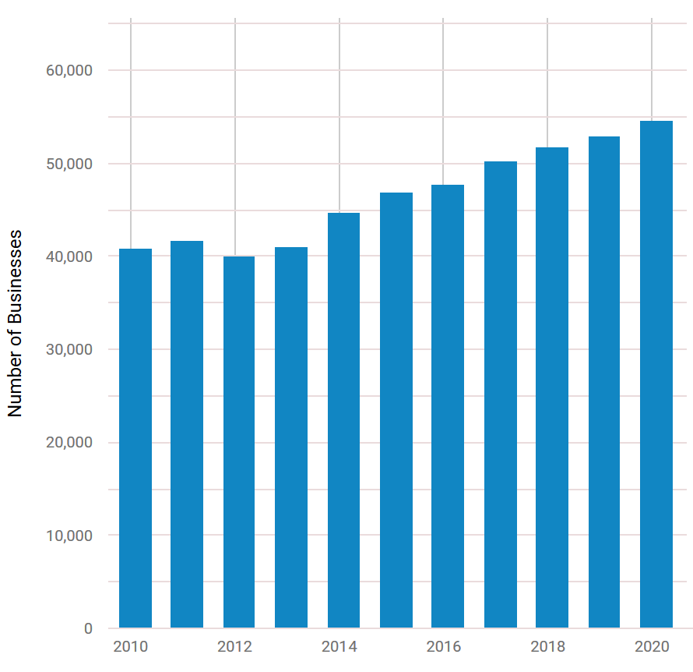
Number of dance studio businesses
Market size in terms of the total number of businesses per year

Slide 4
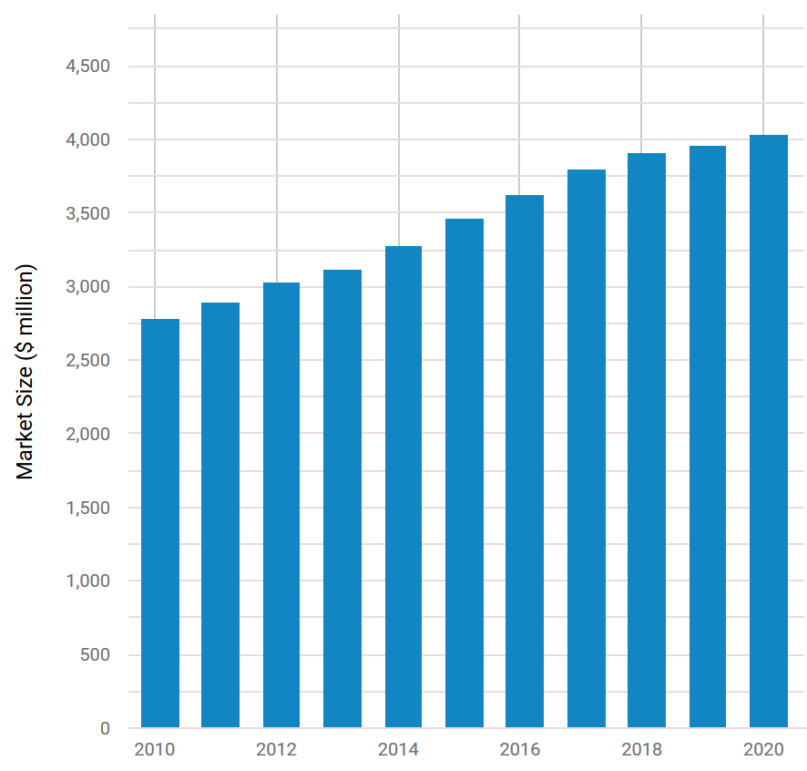
Dance studio market size
Market size in terms of millions of dollars per year

